Slide 1
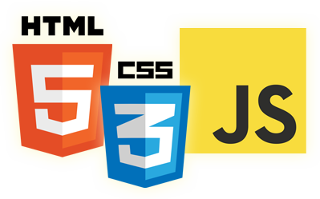


JavaScript Events
Eyal Vardi
Microsoft MVP ASP.NET blog: eyalvardi.wordpress.com

Slide 2
Agenda
Event flow
Event handlers
Event Types
Custom Event

Slide 3
Event Flow

Slide 4
Events History
DOM Level 2 was the first attempt to standardize the DOM events API in a logical way.
DOM Level 2 Events specification doesn’t cover all event types.
DOM Level 3, the current release of the DOM specification, published in April 2004
BOM events and the relationship between these and the DOM events.

Slide 5
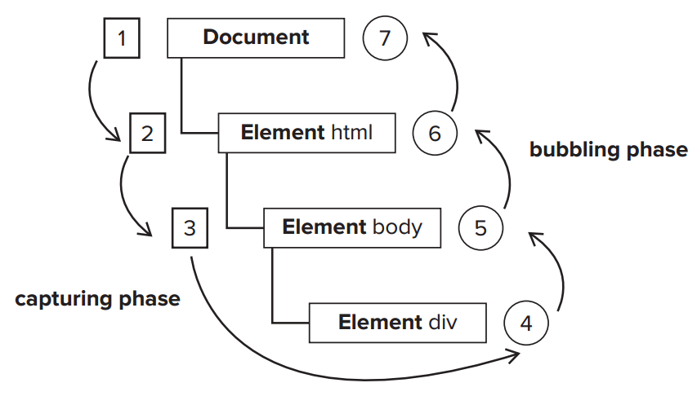
Event Flow in DOM Level 2
Event flow - describes the order in which events are received on the page.

Slide 6
Event Handlers

Slide 7
DOM Level 0 Event Handlers
Events are certain actions performed either by the user or by the browser itself.
click, load, mouseover…
Event handlers have names beginning with “on”.
Onclick, onload
<input type="button" value="Click" onclick="alert('Hi')" />

Slide 8
HTML Event Handlers
Event handlers assigned on the HTML have some unique aspects.
First, a function is created that wraps the attribute value.
That function has a special local variable called event.
The this value inside of the function is equivalent to the event’s target element.
<input type="button" value="Click"
onclick="alert(event.type + ':' + event.target)" />
<input type="button" value="Click" onclick="alert(this.value)" />

Slide 9
Dynamic Function
Members of both document and the element itself can be accessed as if they were local variables.
function(){
with(document){
with(this){
//attribute value
}
}
}
<input type="button" value="Click" onclick="alert(value)" />

Slide 10
Dynamic Function
If the element is a form input element, then the scope chain also contains an entry for the parent form element
<form method="POST">
<input type="text" name="uName" >
<input type="button" onclick="alert(uName.value)">
</form>
function(){
with(document){
with(this.form){
with (this) {
//attribute value
}
}
}
}

Slide 11
HTML Event Handlers Cons
It’s possible that the HTML element appears on the page and is interacted with by the user before the event handler code is ready.
The scope chain augmentation in the event handler function can lead to different results in different browsers.
Tightly couples the HTML to the JavaScript

Slide 12
DOM Level 1 Event Handlers
The event handler is considered to be a method of the element.
this == element
var btn = document.getElementById("myBtn");
btn.onclick = function(){ alert("Clicked"); };
btn.onclick = null; //remove event handler

Slide 13
DOM Level 2 Event Handlers
addEventListener() and removeEventListener().
Exist on all DOM nodes and accept three args:
The event name to handle,
The event handler function,
A Boolean value , Capture phase (true) or during the bubble phase (false).
var btn = document.getElementById("myBtn");
btn.addEventListener("click", function(){ alert(this.id); }, false);
Multiple event handlers can be added

Slide 14
Event Object

Slide 15
The Event Object
When an event related to the DOM is fired, all of the relevant information is gathered and stored on an object called event.
The event object contains properties and methods related to the specific event that caused its creation.
document.body.onclick = function(event){
alert( event.currentTarget === document.body ); //true
alert( this === document.body); //true
alert( event.target === document.getElementById("myBtn")); //true
};

Slide 16
Type Property
Useful when you want to assign a single function to handle multiple events.
var btn = document.getElementById(“myBtn”);
var handler = function(event){
switch(event.type){
case "click":
alert("Clicked");
break;
case "mouseover":
event.target.style.backgroundColor = "red";
break;
case "mouseout":
event.target.style.backgroundColor = "";
break;
}
};
btn.onclick = handler;
btn.onmouseover = handler;
btn.onmouseout = handler;

Slide 17
The preventDefault() Method
Used to prevent the default action of a particular event.
var link = document.getElementById("myLink");
link.onclick = function(event){ event.preventDefault(); };

Slide 18
The stopPropagation() Method
Stops the flow of an event through the DOM structure immediately, canceling any further event capturing or bubbling before it occurs.
var btn = document.getElementById("myBtn");
btn.onclick = function(event){
alert("Clicked");
event.stopPropagation();
};
document.body.onclick = function(event){
alert("Body clicked");
};

Slide 19
The eventPhase Property
Determining what phase of event flow is currently active.
var btn = document.getElementById("myBtn");
document.body.addEventListener("click", function(event){
alert(event.eventPhase); // 1, capturing phase
}, true);
btn.onclick = function(event){
alert(event.eventPhase); // 2
};
document.body.onclick = function(event){
alert(event.eventPhase); //3
};

Slide 20
Event Type

Slide 21
Event Types
DOM Level 3 Events specifies the following event groups:
UI
Focus
Wheel
Text
Keyboard
Composition
Mutation

Slide 22
Memory & Preformance

Slide 23
Memory & Preformance
In JavaScript, the number of event handlers on the page directly relates to the overall performance of the page.
Each function is an object and takes up memory.
The amount of DOM access needed to assign all of the event handlers up front delays the interactivity of the entire page.

Slide 24
Event Delegation
The solution to the “too many event handlers” issue is called event delegation.
var list = document.getElementById("myLinks");
EventUtil.addHandler(list, "click", function(event){
event = EventUtil.getEvent(event);
var target = EventUtil.getTarget(event);
switch(target.id){
case "doSomething":
document.title = "I changed the document’s title";
break;
case "goSomewhere":
location.href = "http://www.wrox.com";
break;
case "sayHi":
alert("hi");
break;
}
});

Slide 25
Removing Event Handlers
When an element is removed from the document while it has event handlers attached you need to remove the event handler to.
removeChild()
replaceChild()
innerHTML

Slide 26
Custom DOM Event

Slide 27
Custom DOM Events
DOM Level 3 specifies a class of events called custom events.
You create a new custom event by calling createEvent('CustomEvent').
The returned object has a method called initCustomEvent(), which takes four arguments:
type(string), bubbles(Boolean), cancelable(Boolean), detail(object)
var event = new Event('build'); // Listen for the event. elem.addEventListener('build', function (e) { ... }, false); // Dispatch the event. elem.dispatchEvent(event);
Demo

Slide 28
Summary
It’s best to limit the number of event handlers on a page.
Event delegation can be used to limit the number of event handlers.
It’s a good idea to remove all event handlers that were added before the page is unloaded.

Slide 29
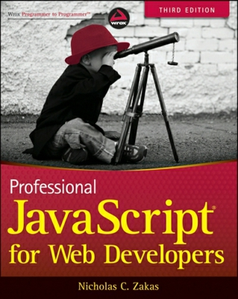
Resources
Professional JavaScript for Web Developers
Good links:
http://eyalvardi.wordpress.com/resources/html-5-course-resourses/javascript/

Slide 30
Thanks
eyalvardi.wordpress.com
Eyal Vardi
Microsoft MVP ASP.NET blog: eyalvardi.wordpress.com

